Slide 1
IE 362 Lecture 4: Linked List, Stack and Queue (Continued)
Il-Chul Moon
Department of Industrial and Systems Engineering
KAIST

Slide 2
Short recap

Slide 3
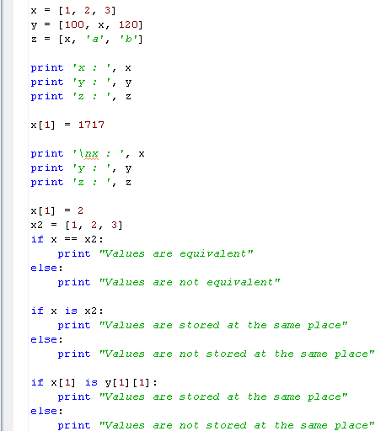
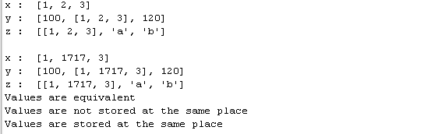
Detour: Assignment and Equivalence
y
1
x
3
reference
x
1
2
3
reference
One variable’s value is changed
But, you see three changes
Why this happened?
Because of references
x has two references from y and z
The values of y and z are determined by x, and x is changed
See the ripple effects
==
Checks the equivalence of two referenced values
is
Checks the equivalence of two referenced objects’ IDs
z
x
a
b

Slide 4
Search procedure in singly linked list
Again, let’s find ‘d’ and ‘c’ from the list
Just like an array, navigating from the first to the last until hit is the only way
No difference in the search pattern, though you cannot use index any further!
Your list implementation may include the index function, but it is not required in the linked list
node.objValue == ‘c’ → False: No hit!
node.objValue == ‘c’ → False: No hit!
node.objValue == ‘c’ → False: No hit!
node.objValue == ‘c’ → False: No hit!
node.objValue == ‘c’ → False: No hit!
head
‘a’
‘b’
‘d’
‘e’
‘f’
tail
After five retrievals,
we found that there will be no hit! (always N retrievals)
node.objValue == ‘d’ → False: No hit!
node.objValue == ‘d’ → False: No hit!
node.objValue == ‘d’ → True: Hit!
After three retrievals,
we found the hit! (maximum N retrievals)

Slide 5
Insert procedure in singly linked list
This is the moment that you see the power of a linked list
Last time, you need N retrievals to insert a value in the array list
This time, you need only three operations
With an assumption that you have a reference to the node, Node_{prev} that you want to put your new node next
First, you store a Node, or a Node_{next}, pointed by a reference from Node_{prev}’s nodeNext member variable
Second, you change a reference from Node_{prev}’s nodeNext to Node_{new}
Third, you change a reference from Node_{new}’s nodeNext to Node_{next}
Node_{new}
(3) Add this reference
(2) Update this reference
‘c’
(1) Store this node
head
‘a’
‘b’
‘d’
‘e’
‘f’
tail
Node_{prev}
Node_{next}
Over-written with a new reference to the new node

Slide 6
Delete procedure in singly linked list
This is the another moment that you see the power of a linked list
Last time, you need N retrievals to delete a value in the array list
This time, you need only three operations
With an assumption that you have a reference to the node, Node_{prev} that you want to remove the node next
First, you retrieve Node_{next} that is two steps next from Node_{prev}
Second, you change a reference from Node_{prev}’s nodeNext to Node_{next}
The node will be removed because there is no reference to Node_{remove}
(2) Update this reference
(1) Retrieve this node that is two step next
head
‘a’
‘b’
‘c’
‘d’
‘e’
‘f’
tail
Node_{prev}
Node_{remove}
Node_{next}
Over-written with a new reference to the next node of the removed one

Slide 7
Structure of Stack
Stacks are linear like linked lists
A variation of a singly linked list
Difference
Voluntarily giving up
Access to the middle in the linked list
Only accesses to the first instance in the list
The first instance in the list
= The top instance in the stack
An item is inserted or removed from the stack from one end called the “top” of the stack.
This mechanism is called Last-In-First-Out (LIFO).
Top Only Accessible
Cargo Object 1
Cargo Object 2
Cargo Object 3
Cargo Object 4
Cargo Object 5
Cargo Object 6

Slide 8
Structure of Queue
Queues are linear like linked lists
A variation of a singly linked list
Difference
Voluntarily giving up
Access to the middle in the linked list == Same to the stacks
Only accesses to the first and the last instances in the list
The first instance in the list
= The front instance in the queue
The last instance in the list
= The rear instance in the queue
An item is inserted at the last
An item is removed at the front
This mechanism is called Fast-In-First-Out (FIFO)
Product 1
Product 2
Product 3
Product 4

Slide 9
Offline class plan

Slide 10
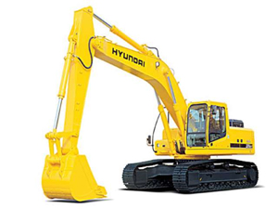
Production Planning Management
Excavator producers in Korea
Hyundai, Doosan…
Excavators are pretty expensive
Start production when orders come in
Any problem?
Orders always change
Cancelling
Changing the delivery date
Changing the specification
Changes get more difficult to handle when they are aggregated for a month-long production list
How to store and manage the production data?

Slide 11
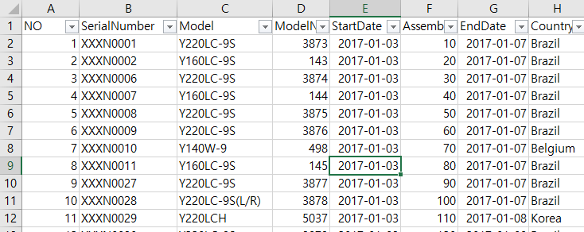
Dataset
You are given four production plans of excavator production
Plan on Dec 17, 2012
This week, we are going to use only this data
Plan on Dec 24, 2012
Plan on Jan 10, 2013
Plan on Jan 11, 2013
Four columns
No: just a number on the row
Serial Number: Unique identifier of an order
Model: Model name of the excavator
Model Number: The unique number of the product in the model line
Start Date: Production start date
Assembly Order: Production order
End Date: Production end date
Country: Order origination

Slide 12
Manufacturing Execution System
Processor 1
Processor 2
Processor 3
Planned Product
Finished Product
Processor 4
Processor 5
Processor 6
Processors have their own list of products to handle
Processor 1,2,3 follows the stack
Processor 4,5,6 follows the queue
Problem 1. Complete the production list class
Code addFirst, removeLast, removeFirst, and getSize
Problem 2. Complete the stack class
Problem 3. Complete the queue class
Problem 4. Complete the arriveProduct method of ManufacturingProcess class
Given “plan” should be added to the method of either stack or queue

Slide 13
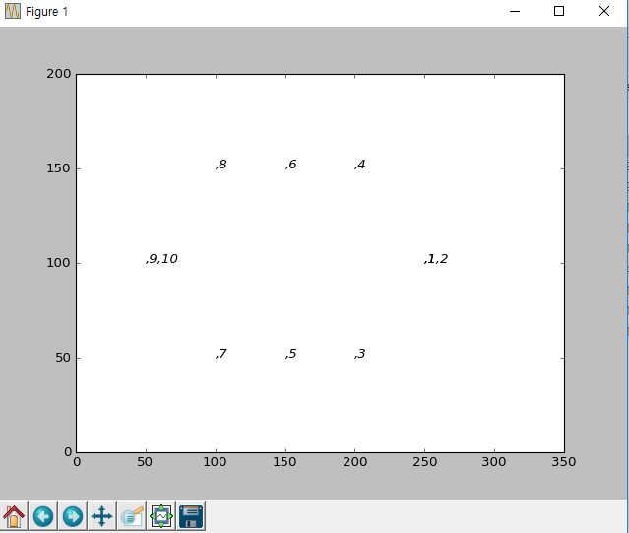
Execution Result
When you complete the codes, you are expected to see the below results.
Execute ‘run.py’

